Slide 1

C# Fundamentals
Course Introduction
SoftUni Team
Technical Trainers
Software University
https://softuni.bg/

Slide 2
Table of Contents
Course Objectives
Training and Team
Course Organization
Course Infrastructure
Evaluation Criteria
2
Notes:
2

Slide 3
Have a Question?
sli.do
#csharp-fund
Notes:
3

Slide 4














SoftUni Diamond Partners

Slide 5

Course Objectives

Slide 6
C# Fundamentals Objectives
Working with linear data structures
Arrays and Lists
Defining simple classes
Processing and manipulating strings
Regular expressions
Building а simple web project

Slide 7
Practical Programming Exam
Mid Exam
3 practical problems for 4 hours
Conditional Statements and Loops
Arrays
Lists
Final Exam
3 practical problems for 4 hours
Associative Arrays
Strings and Text Processing
Regular Expressions

Slide 8
Theoretical Exam
You will have 30 minutes once you enter
Multiple-choice with 1 or more correct answers
English
Automated quiz system
Available during the practical exam and 30 minutes after it
You can submit your answers just one time
Advice: Start it when you finish the practical exam

Slide 9

Course Organization

Slide 10
C# Fundamentals Module
18-May-2020
5-July-2020
9-August-2020
15-August-2020
C# Fundamentals
12 weeks * 3 times / week 18 credits
Start: 18-May-2020
Mid Exam: 5-July-2020
Theoretical Exam: 9-August-2020
Final exam: 9-August-2020
Re-Take Exams
Mid Exam Retake: 12-August-2020
Тheoretical Exam: 15-August-2020
Final Exam Retake : 15-August-2020

Slide 11

Homework Assignments & Exercises
Your homework is mainly work in class
Lesson days → slides + live demos + exercises
Exercise days → only exercises
How to submit your homework?
Submitted in the judge system
Do your homework when it's due
Assignments pile up quickly

Slide 12



Scoring System for the Course
Theoretical Exam 5%
Practical Exam (Final + Mid) 95%
Evaluation
Homework 5 %

Slide 13

The Team

Slide 14
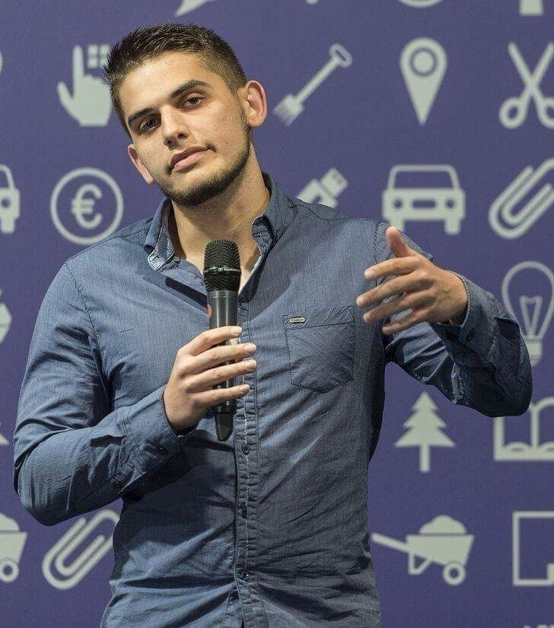
Viktor Dakov
Senior Developer SDE 3, Nuvolo
Worked at Amazon
John Atanasoff award
Participated in many programming contests
6+ Years of Experience as a Developer

Slide 15
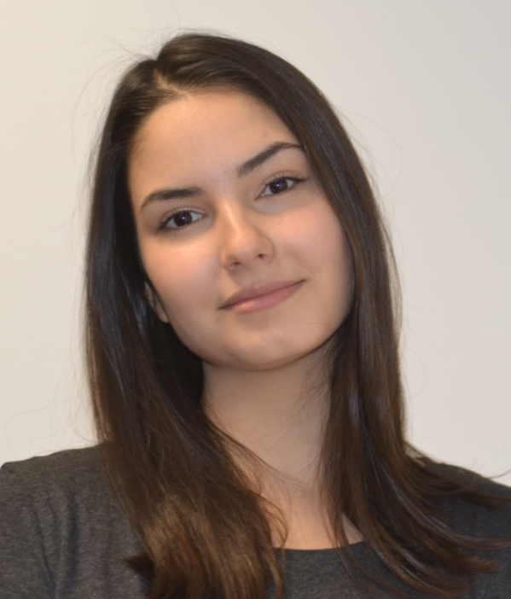
Sanya Kasarova
Program Lead @ SoftUni
Student – Software engineering in SoftUni, Math & Informatics at Sofia University (SU)
Passionate about C#, HTML & CSS, JS

Slide 16


Course Web Site, Forum and FB Group
Official web site:
Official discussion forum:
C# Fundamentals Facebook group:
softuni.bg/trainings/2438/csharp-fundamentals
softuni.bg/forum/categories/44
https://www.facebook.com/groups/FundamentalsModuleMay2020/

Slide 17
Questions?
Notes:
17

Slide 18
Trainings @ Software University (SoftUni)
Software University – High-Quality Education, Profession and Job for Software Developers
softuni.bg
Software University Foundation
softuni.foundation
Software University @ Facebook
facebook.com/SoftwareUniversity
Software University Forums
forum.softuni.bg
Notes:
18

Slide 19

License
This course (slides, examples, demos, exercises, homework, documents, videos and other assets) is copyrighted content
Unauthorized copy, reproduction or use is illegal
© SoftUni – https://about.softuni.bg/
© Software University – https://softuni.bg
Notes:
19

